Slide 1

Dispatch Management

Slide 2

INTRODUCTION
Track your vehicles, promote safety, save fuel, boost profits and improve your dispatching by making up to the minute deliveries with our Dispatch Management module and optimize your operations by establishing business efficiently

Slide 3


Delivery Dispatch Management Software
We provide a state-of-the-art Delivery Dispatch Management Software for all kinds of freight forward & dispatch solutions like E commerce and courier companies, on demand delivery apps for food, grocery, medicine etc. and many more

Slide 4

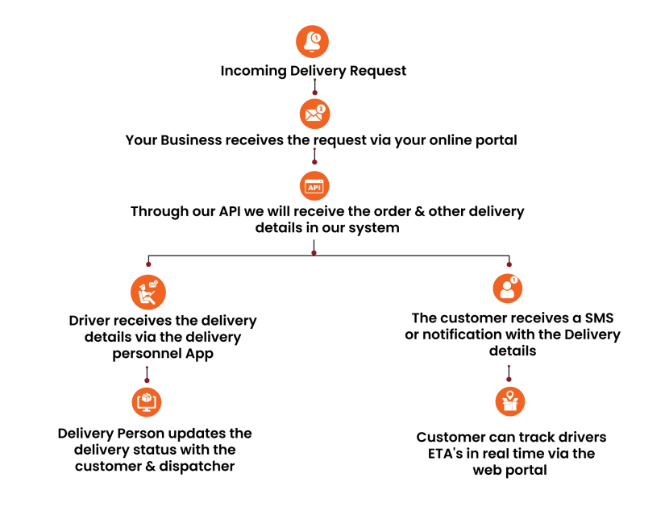

Slide 5
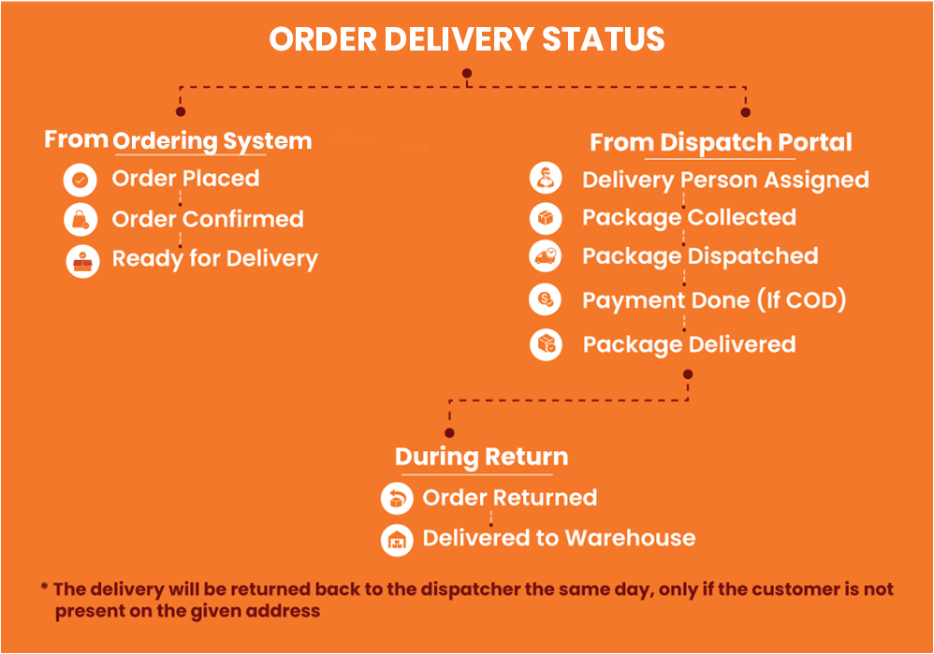

Slide 6

Benefits of Using our Dispatch Module
01
Optimize in Real Time
02
Create Business Processes with business objectives
03
Develop accurate Schedules using Historical data
04
Automate from Overrides to automated functions
05
Dispatch your services with mobile Apps
06
Optimize Schedules using real-time traffic patterns
07
Better access to time sensitive information

Slide 7





Features
Route Optimization
Live ETA's & Tracking
Automate Dispatch
Automated Logistics
With our dispatch module you can remove the daily hassles of manually routing the drivers and tasks, & ensure optimal efficiency in your day to day operations
Keep track of your daily operations by our software & communicate with your
drivers in real time and gain clear visibility into the current ETA's & many more
Avoid sending delivery tickets one by one, with our completely automated system newly created tickets will be assigned to the driver closest to the destination or to the driver who first accepts the delivery ticket.
With our software you can dispatch your logistics solutions without any manual processes, you will receive automated schedules and routes providing
ease to your daily management process

Slide 8




Features (cntd.)
Integration
Seamless Data Handling
Real Time Tracking
Detailed Dispatcher Dashboard
Integrate your existing delivery order management portals and website to our system effortlessly and continue to deliver hassle-free
You can upload CSV/Excel files in bulk with complete mapping & integrate it
into our system via API
Track in real time with fleet management, get a centralized view of your
processes, react and re-optimize in real time with customizable notifications
With our Dispatch module comes an all in one dispatcher needs on one screen. You can identify each order and understand the most important
information of the delivery. You can easily assign dispatchers on work orders efficiently

Slide 9



Ordering System Integration & API
HandShake API
In the first level of communication we pass handshaking details to connect both apps together and all order details to dispatch system.
Have an existing ordering system? We can easily integrate your ordering system with the Delivery Dispatch Management System.
Even if you are currently accepting orders by means of phone calls, there is facility to simply enter order details directly into the system. And the best part is this works whether you are a :
A single vendor with single warehouse
Single vendor with multiple warehouse
Multiple vendors in a specific region / city
Dispatch Management To MarketPlace API
In second level communication we pass all order status to marketplace application along with order tracking facility.

Slide 10
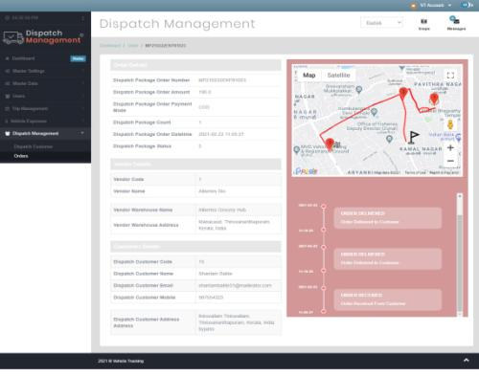
Reports
Some Reports you get : -
Dispatch Customer Order Report - It will show the report of how many orders done by each customer and its details.
Vehicle Running reports
Historical Movement report
Audit Reports
Maintenance Reports
User Reports

Slide 11






Why you need a Dispatch Management Software
Increases Efficiency
Lowers Fuel Costs
Provides Service Consistency
Increases your Company's Reputation
Increases Your Sales

Slide 12

Now Subscribe at
$3 monthly
per Delivery person
No additional costs
We will provide APIs for integration
PRICING
* If you want to use in a branding of your choice, we provide that for extra $3000(without code). The code would be managed by us, and we will provide APIs for integration

Slide 13




CONTACT US
sales@fleetmanagement.ae
fleetmanagement.ae
+971 55 818 8662

Slide 14

THANK YOU

